Slide 1
SUPERSTORE SALES ANALYSIS DASHBOARD
Excel Dashboard Project
Presented by
Aiswarya OP

Slide 2
PROBLEM STATEMENT / BUSINESS OBJECTIVES
Problem Statement
Sales data contains valuable insights, but analyzing large datasets manually consuming and difficult. An interactive dashboard helps visualize sales performance and supports better business decisions.
Business Objectives
Analyze overall Superstore sales performance.
Identify sales and profit trends.
Compare sales across product categories.
Analyze customer segments and regions.
Evaluate shipping mode preferences.
Develop an interactive Excel dashboard for business decision-making.

Slide 3
DATASET OVERVIEW
DATASET INFORMATION
Industry: Retail (Superstore Orders)
Data Source: Superstore orders CSV dataset
Records: 51,290 Orders
Columns: 21
Tool Used: Microsoft Excel
MAIN COLUMNS
Order ID, Order Date, Ship Mode, Customer Name, Segment, Region, Category, Sub-Category,
Product Name, Sales, Profit, Quantity, Discount.

Slide 4
DATA UNDERSTANDING
Before creating the dashboard, the dataset was analyzed to understand its structure.
The following were identified:
Numerical columns
Categorical columns
Date fields
Customer and sales-related attributes
This helped in selecting appropriate Pivot Tables and charts for analysis.

Slide 5
DATA CLEANING AND PREPARATION
Data Cleaning Process
Checked missing values.
Removed duplicate records.
Verified data types.
Applied proper number formatting.
Created Pivot Tables.
Prepared data for dashboard creation.
KPIs Created
Total Sales
Total Profit
Total Orders
Total Quantity

Slide 6
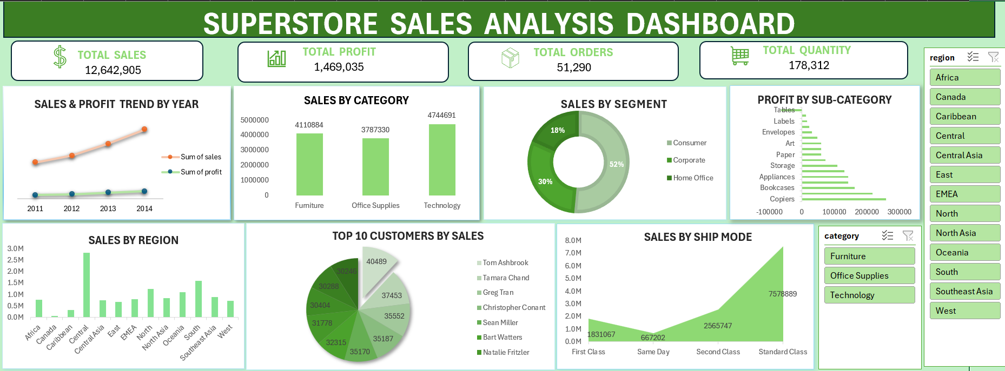
DASHBOARD SCREENSHORT

Slide 7
Dashboard Components
KPI Cards
Total Sales
Total Profit
Total Orders
Total Quantity
Visualizations
Sales & Profit Trend by Year – Line Chart
Sales by Category – Column Chart
Sales by Segment – Donut Chart
Profit by Sub-Category – Horizontal Bar Chart
Sales by Region – Column Chart
Top 10 Customers by Sales – Pie Chart
Sales by Ship Mode – Area Chart
Filters
Region
Category.

Slide 8
INSIGHTS AND FINDINGS
Total Sales: 12.64M
Total Profit: 1.47M
Total Orders: 51.29K
Total Quantity Sold: 178.31K
Sales showed steady growth from 2011 to 2014.
Technology had the highest sales.
Consumer segment contributed the largest share of sales (52%).
Standard Class generated the highest sales.
Central region recorded the highest sales.

Slide 9
CHALLENGES FACED
Challenges
Cleaning and organizing the dataset.
Creating Pivot Tables.
Color Selection.
KPI Formatting.
Selecting suitable chart types.
Designing an interactive dashboard.
Maintaining a consistent dashboard layout.

Slide 10
LIMITATIONS & FUTURE ENHANCEMENTS
Limitations
Static dataset.
No real-time updates.
Limited customer information.
Future Enhancements
Add monthly sales forecasting.
Connect live database.
Build dashboard in Power BI.
Add more interactive filters.

Slide 11
TOOLS & TECHNOLOGIES
Tools Used
Microsoft Excel
Pivot Tables
Pivot Charts
Slicers
Data Visualization Techniques

Slide 12
CONCLUSION
The Superstore Sales Analysis Dashboard provides an interactive overview of sales performance using Excel.
It helps users to:
Monitor sales and profit.
Compare product categories.
Analyze customer segments.
Evaluate regional performance.
Support data-driven business decisions.

Slide 13
THANK YOU

